Slide 1



2025 MLB
DATA ANALYSIS
Group 11
David Sweasey, John Farrell, and Morgan Rivera

Slide 2
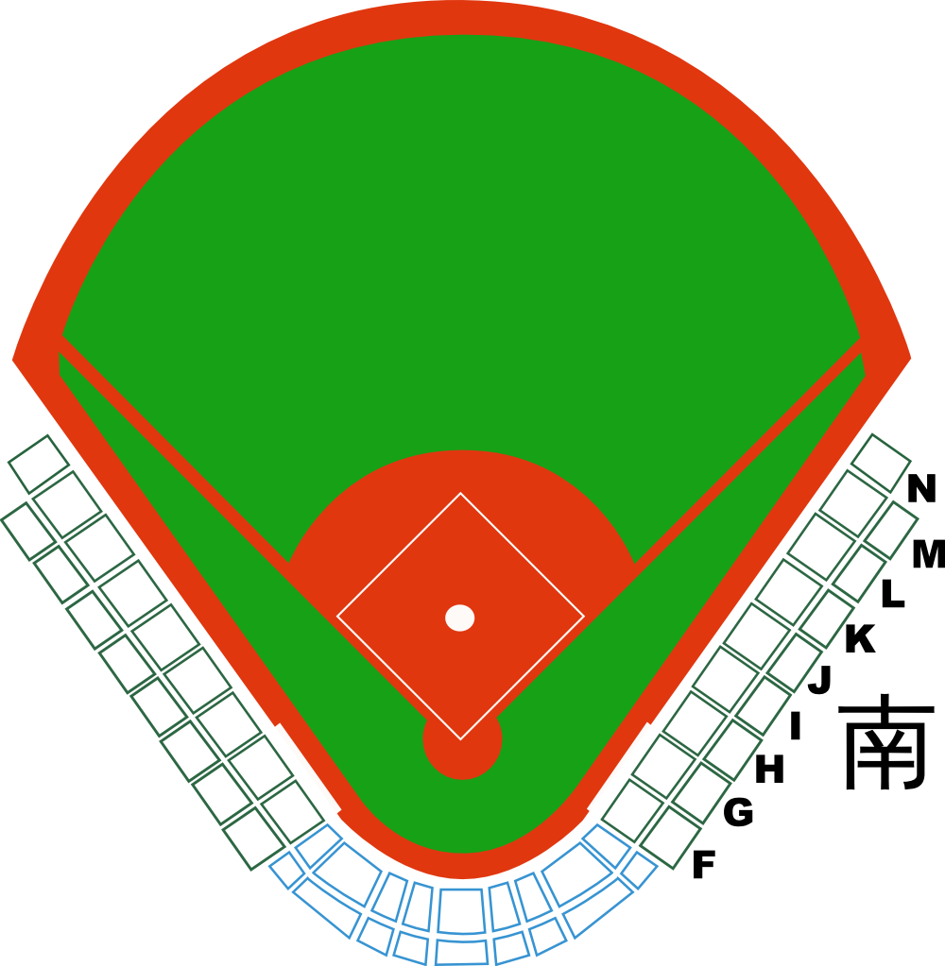
Team Composition
DAVID
Introduced missing values to datasets
Data cleaning
Data merging
JOHN
Found datasets
Data cleaning
MORGAN
Data dictionary
Data cleaning
Data exploratory analysis
MOTIVATION
We are interesting in baseball
Baseball has a TON of statistics, lending itself nicely to data science
Offense is the best part of baseball, so we chose offensive statistics

Slide 3
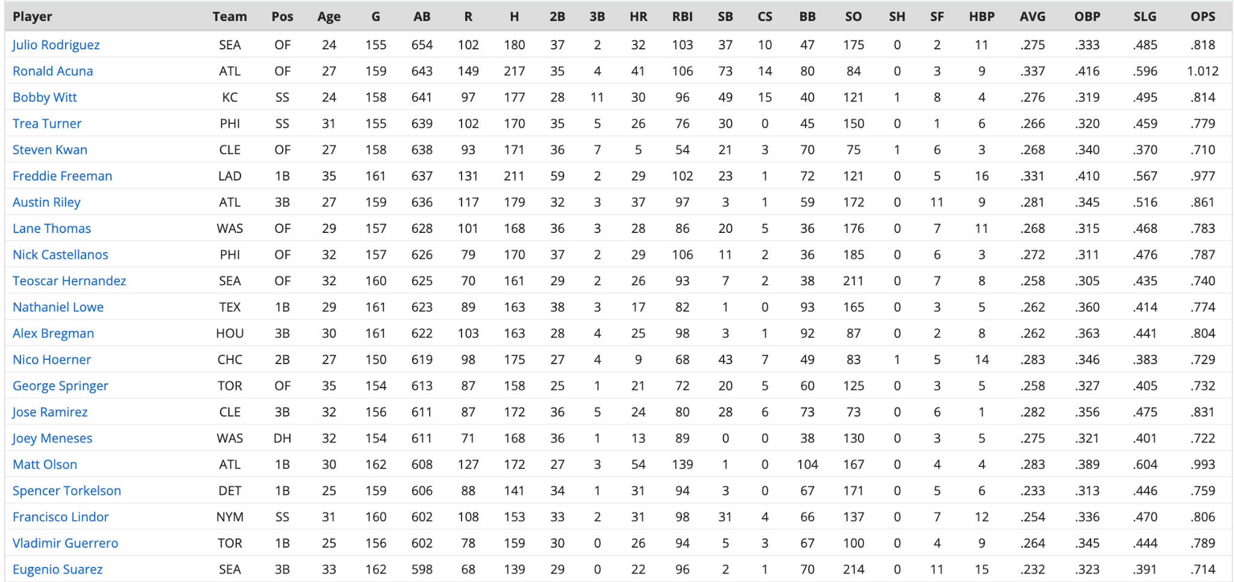
Selecting dataset
Rotowire offered well-organized MLB statistics over multiple years
Compiled nicely, and easy to retrieve CSV files
Nice for statistical analysis because of the high number of events
300 pitches a game, various velocities, etc.
Datasets include 23 explanatory variables related to MLB batting statistics
Evaluate team and player performance

Slide 4
Timeline
1/27 Team meeting, contract, agenda
2/13 Meet with Dr. AM to approve datasets
2/23 Introduce missing data values
2/24 Team meeting to clean and wrangle data, and setup GitHub
2/25 Merge datasets
2/25 Final cleaning and wrangling
3/1 Exploratory data analysis
3/2 Midterm report, start presentation
3/3 Update GitHub, finish presentation and midterm report

Slide 5
Core Features for Exploratory Analysis
We want to use player batting statistics to derive each team’s offensive firepower and how likely they will be to succeed in the 2025 season.
Variables used: Team, batting average (AVG), runs batted in (RBI), stolen bases (SB), and home runs (HR)
Variables computed: Plate appearances (PA)

Slide 6

Dataset
Original data: The datasets we chose were from rotowire for the 2023 and 2024 baseball seasons. These datasets list out batting information about each player in the MLB including names, games played, and other baseball statistics important for analysing the performance of each player.
Subset of original data: Removed players traded if they did not exist in both datasets meaning that they retired from baseball or did not participate that season.
Unit of observation: Player
Modify the data to change the unit of observation: Team

Slide 7
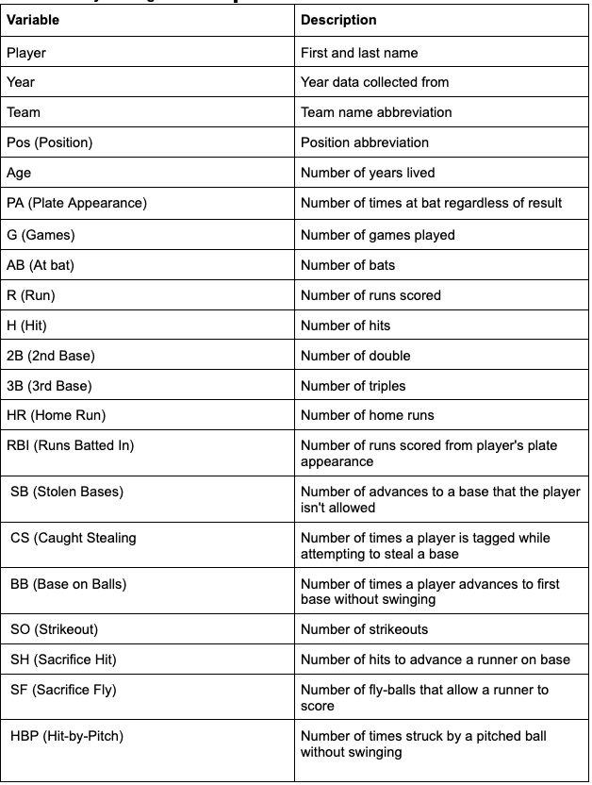
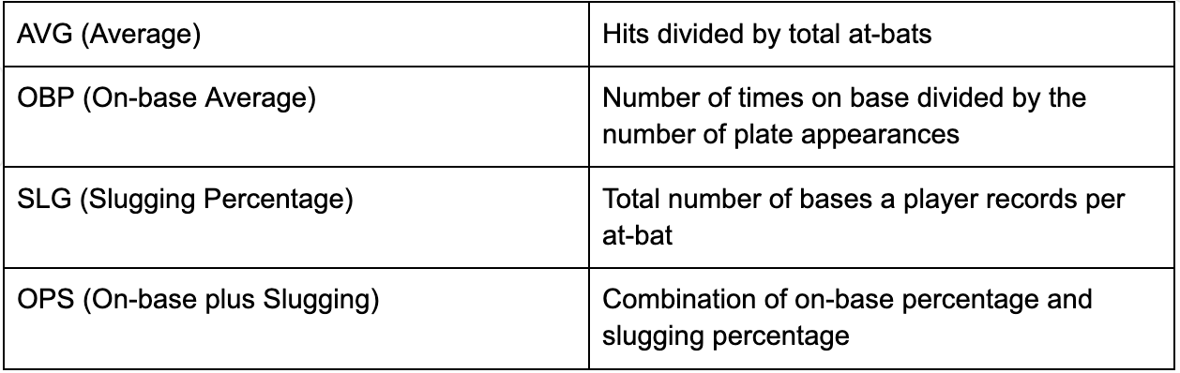
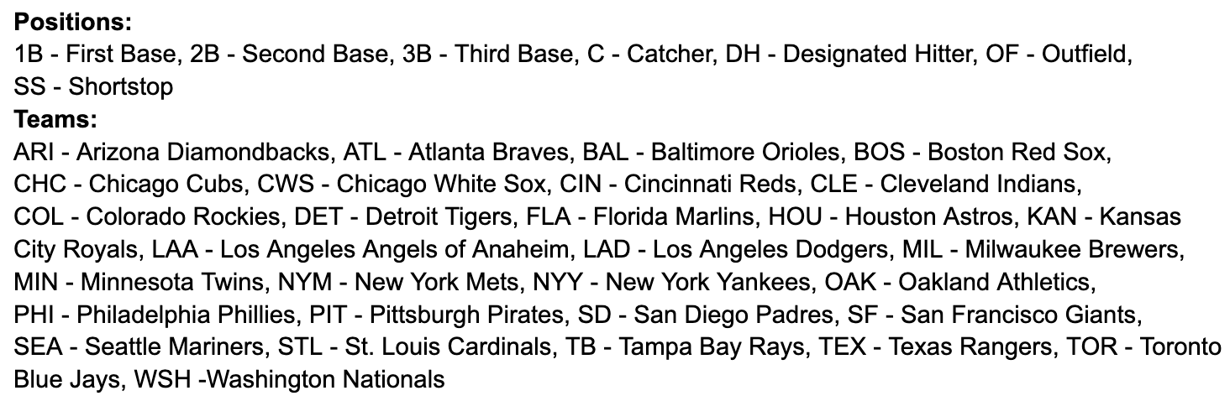
Dataset

Slide 8

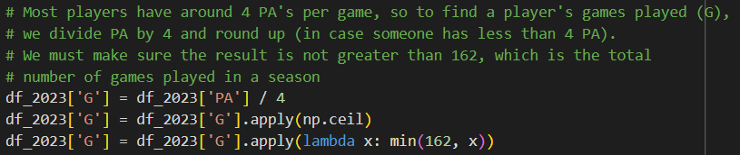
Cleaning
Added a Year column to both datasets
Verified the shapes and column names of the dataframe
Identified columns with missing values (SH, SF, and G)
Replaced missing SF (sacrifice flies) and SH (sacrifice bunts) with 0
Create Plate Appearances (PA) statistic
At Bats (AB) + SF + Walks (BB) + Hit By Pitch (HBP)
Filled missing Games Played (G) columns

Slide 9

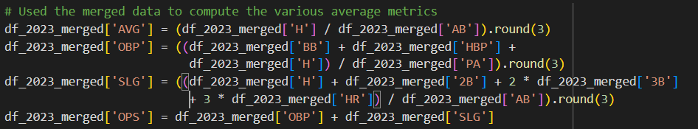
Cleaning
Dropped 2023 Team Column
For duplicate players, we aggregated their stats into one entry
Ensured data formats were standardized

Slide 10
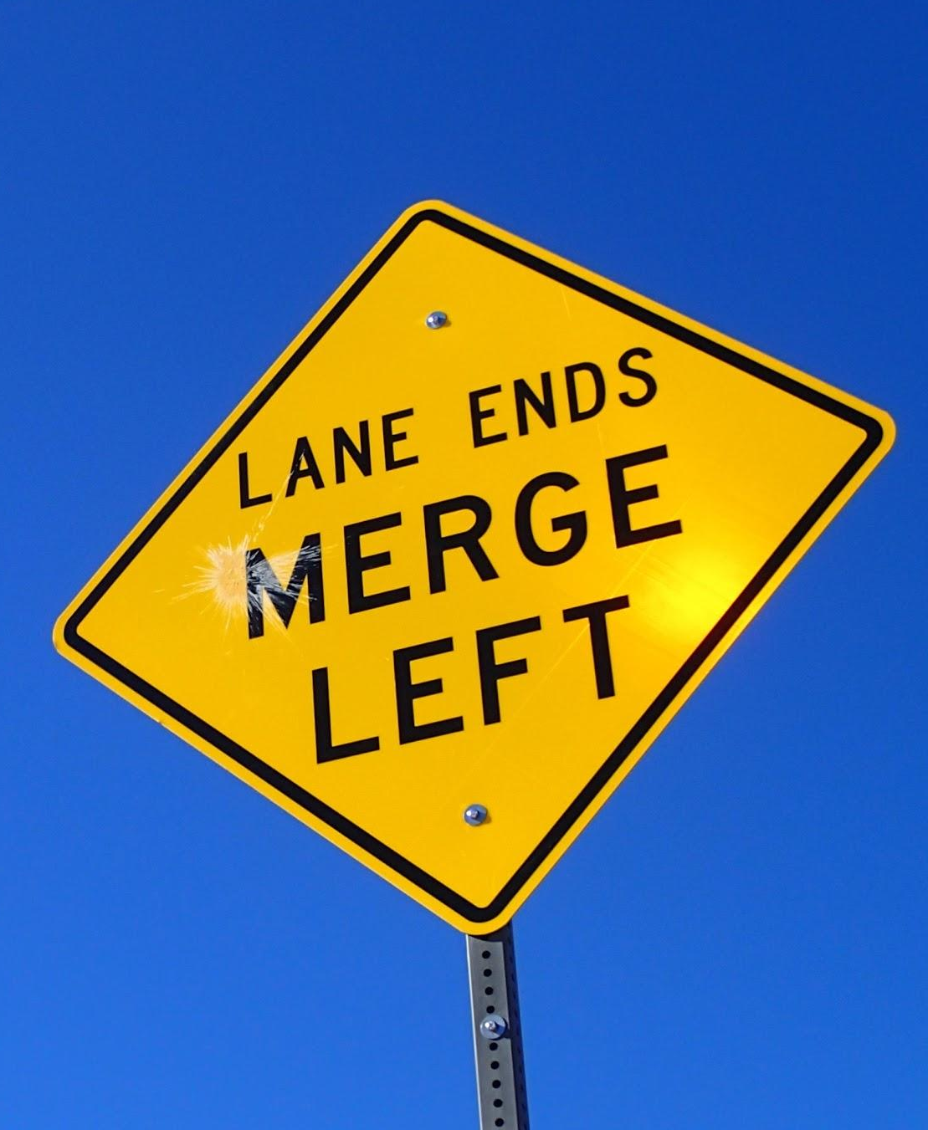
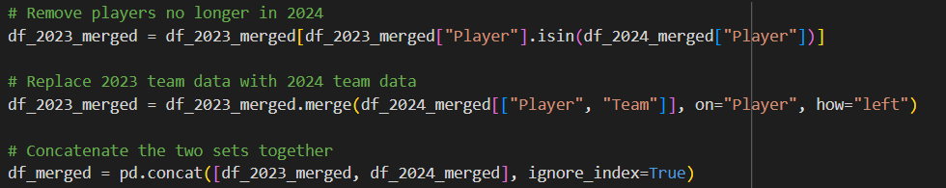
Merging
Before merging, removed players from the 2023 dataset who were not in the 2024 dataset
Added team column back to 2023 dataset with each player’s most recent team
Concatenated the two sets together

Slide 11
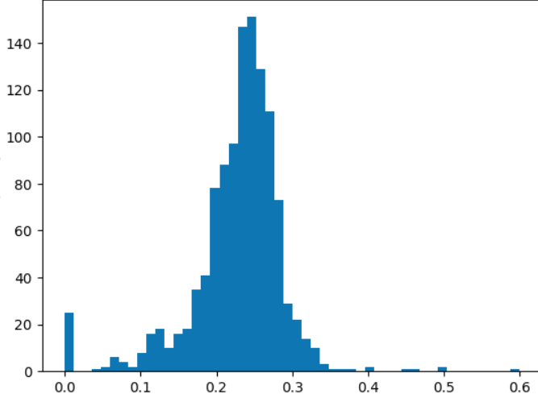


Wrangling
Analyzed AVG summary statistics for outliers
Even the best players do not have a batting
Average greater than 0.400
Removed players at or above 0.400 and at 0.0
AVG

Slide 12

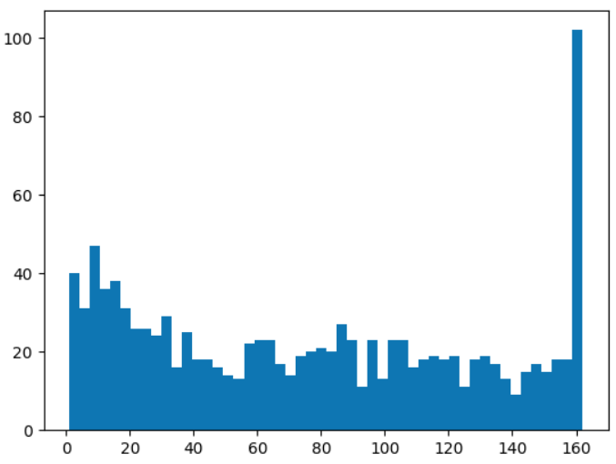

Wrangling
Analyzed Games Played (G) for outliers
Players with 20 or less games played
have not played enough games for their
statistics to be reflective of their skill
Games Played (G)

Slide 13
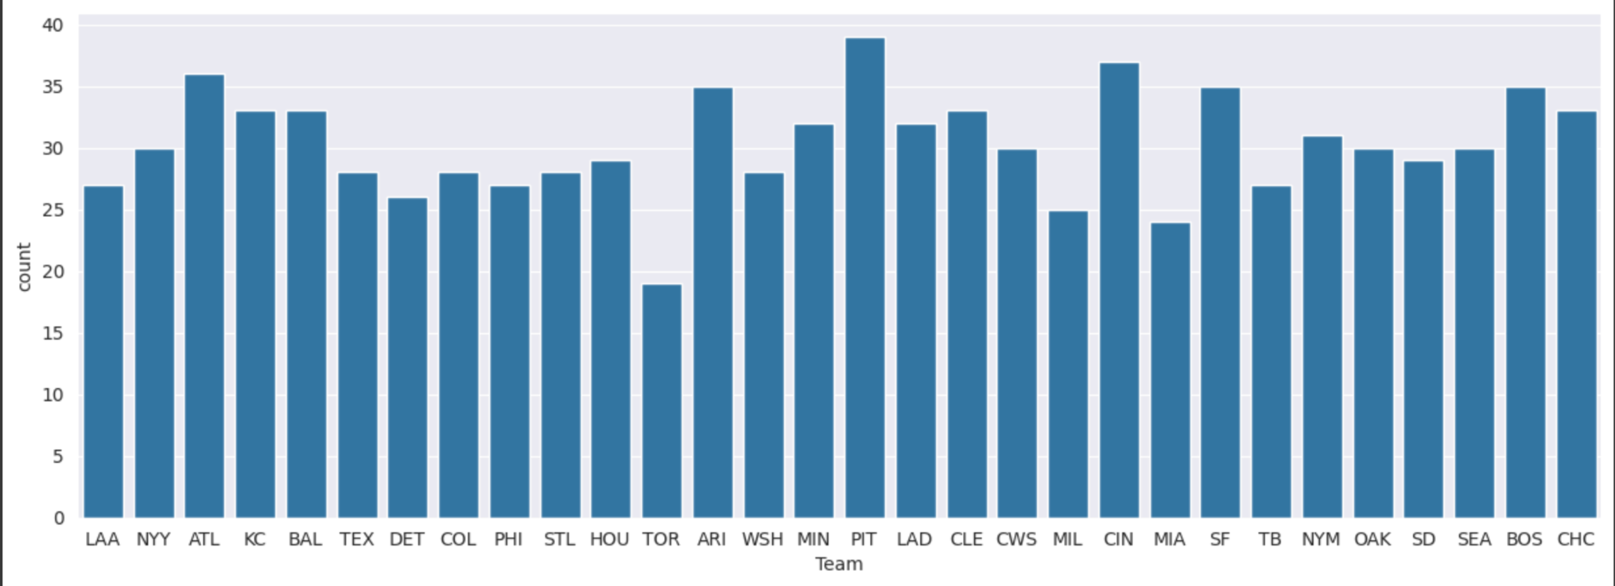
Exploratory Analysis
Univariate analysis: relatively normal, with no significant outliers or unusual patterns
Number of players to each team

Slide 14
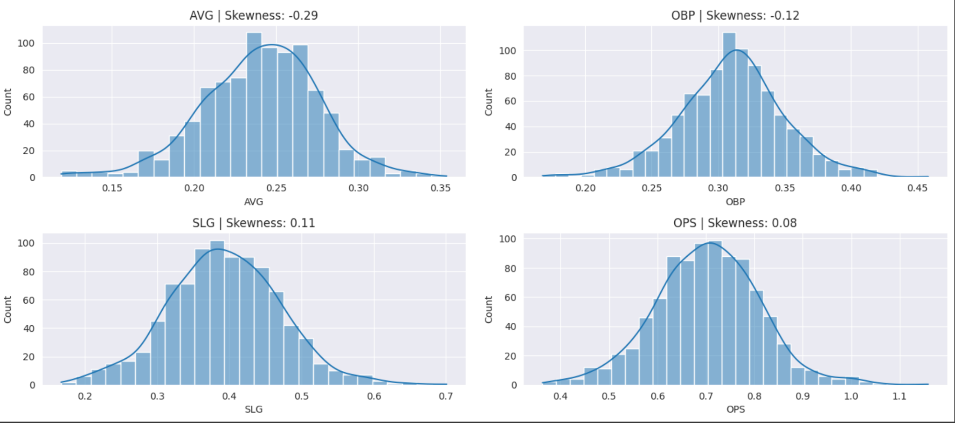
Exploratory Analysis
Univariate analysis: relatively normal, with no significant outliers or unusual patterns
Kernel density plots

Slide 15
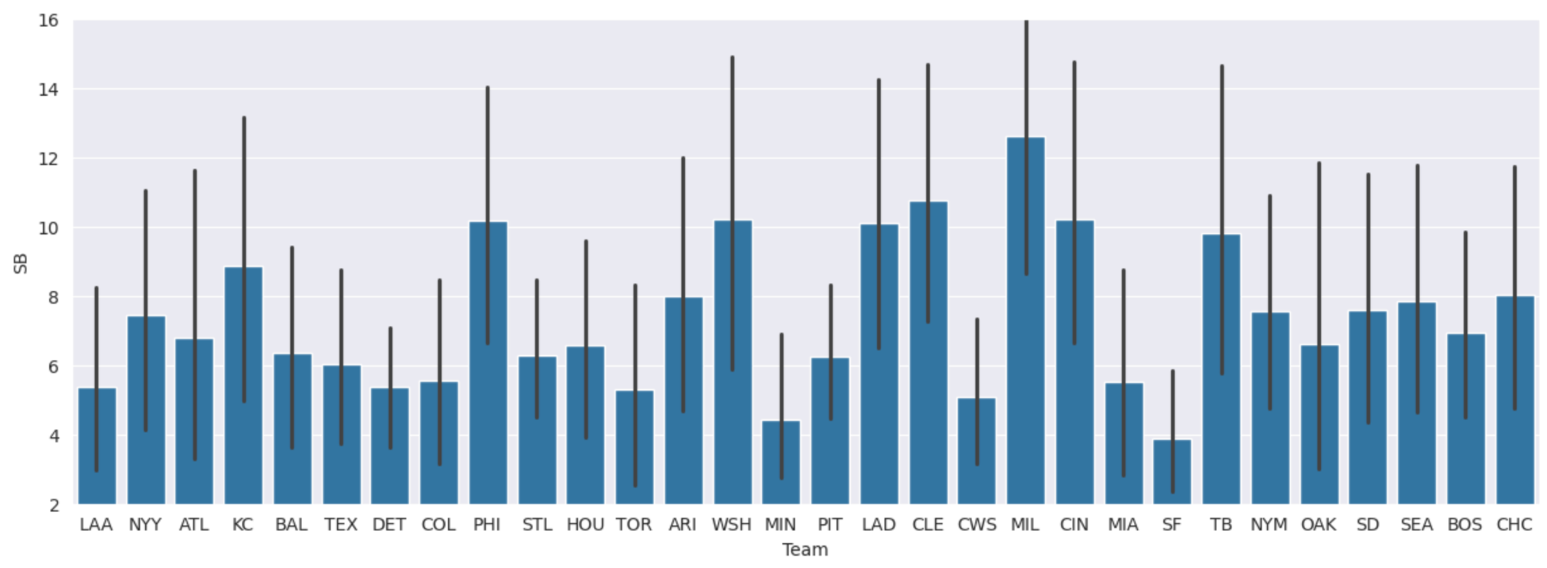
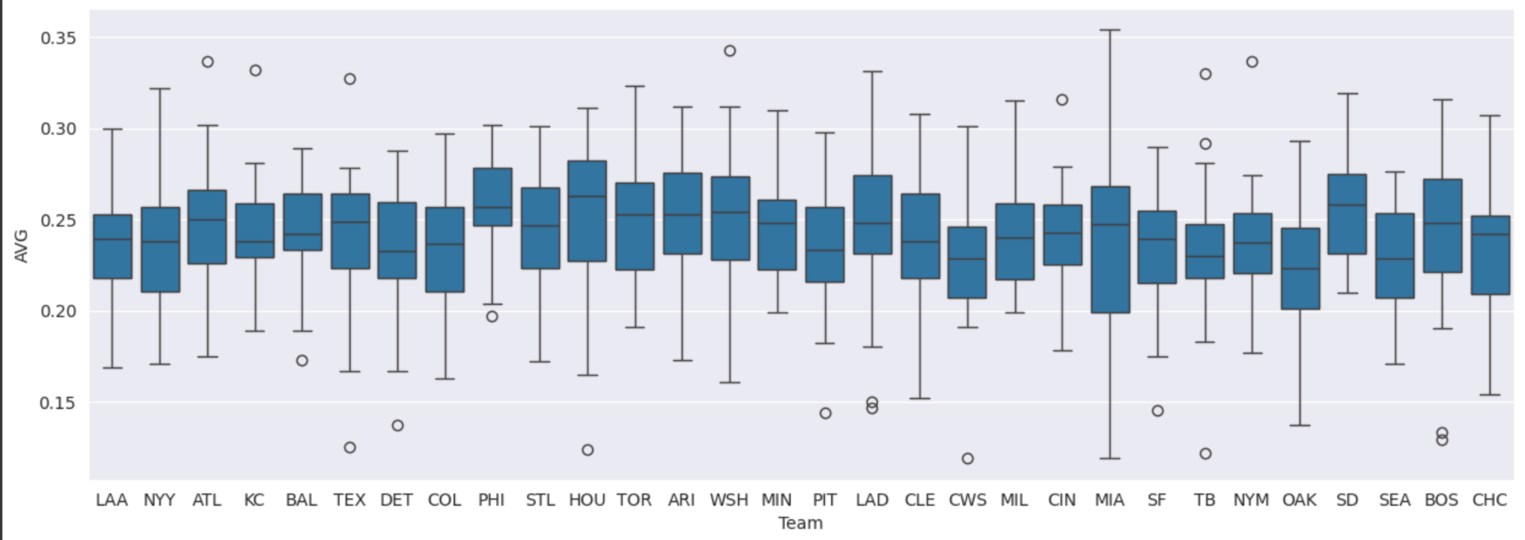
Exploratory Analysis
Bivariate analysis: large variability in performance between teams
Stolen Bases (SB)
Batting Average (AVG)

Slide 16
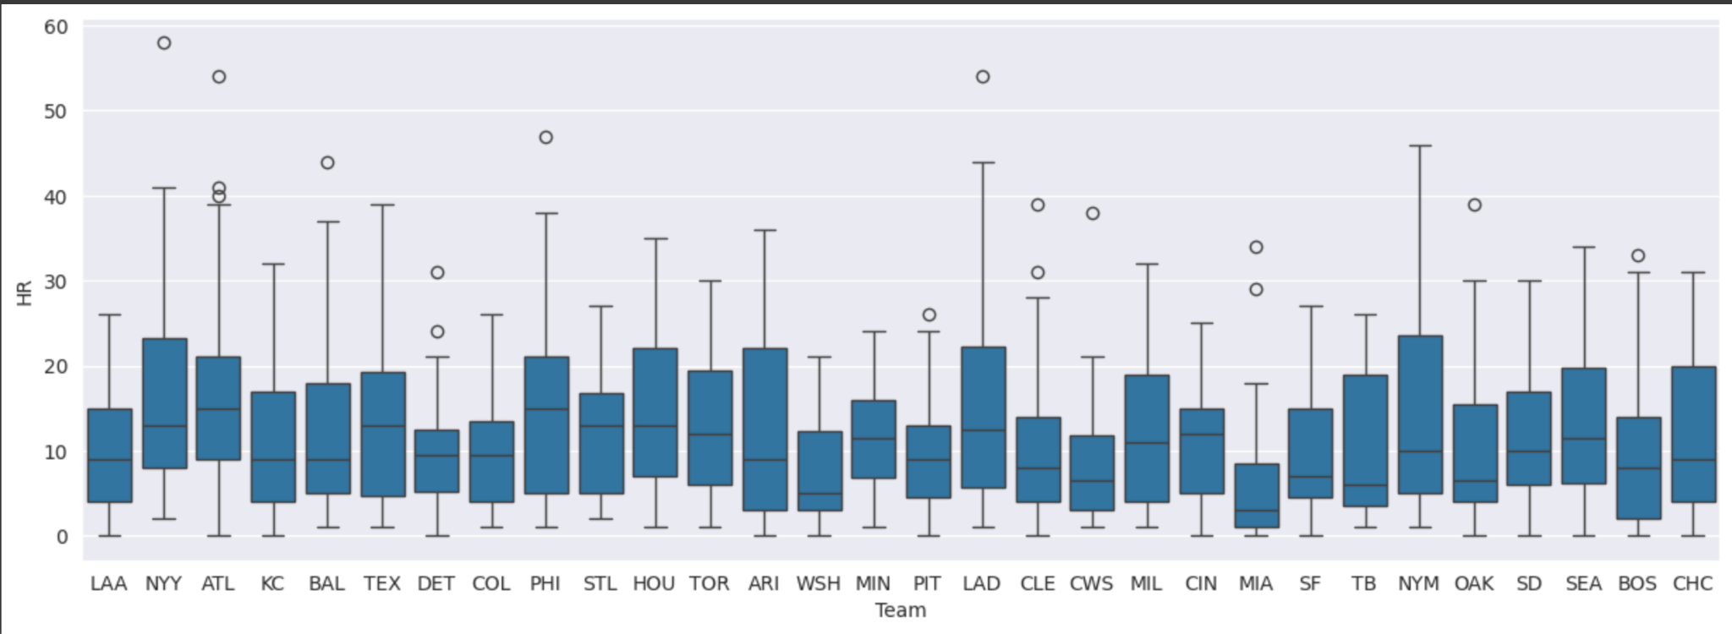
Exploratory Analysis
Bivariate analysis: considerable variance showing teams with many strong hitters
Home Runs (HR)
Notes:
Dataset: Describe your original dataset and if you only used a subset describe the subset as well. What datasets were chosen, what was the unit of observation, did you modify the data to change the unit of observation (5 points)

Slide 17
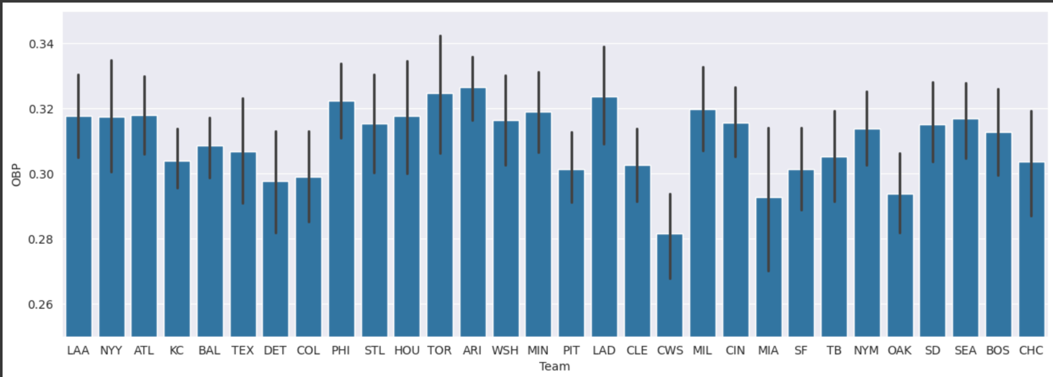
Exploratory Analysis
Bivariate analysis: low variability showing team’s consistency at getting on base
On-base percentage (OBP)

Slide 18
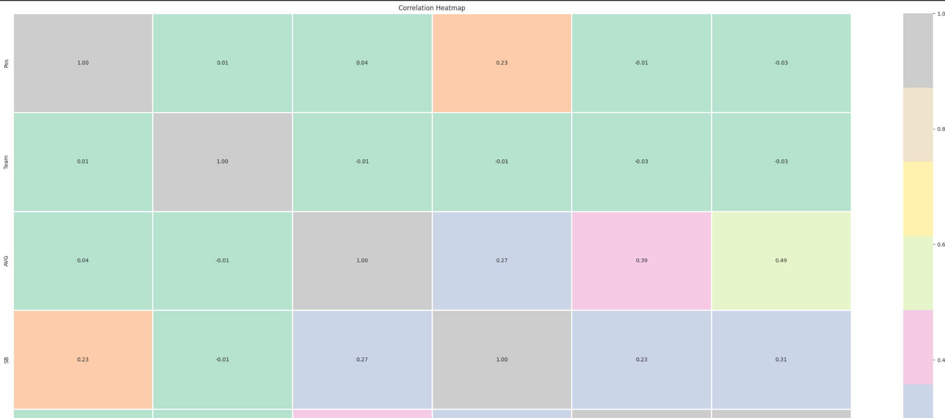
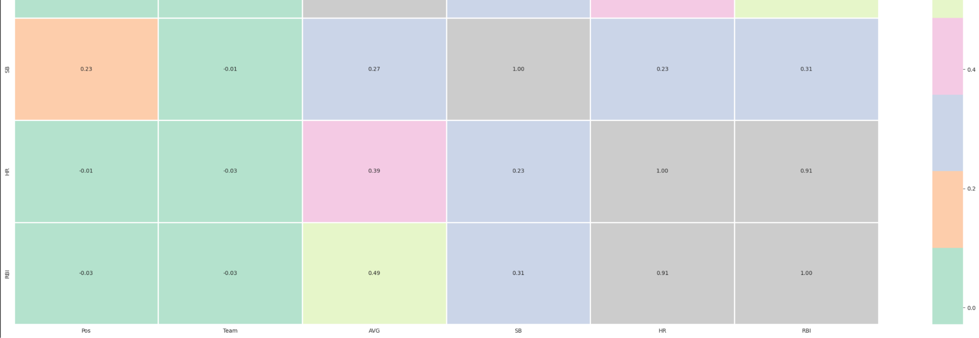
Exploratory Analysis

Slide 19
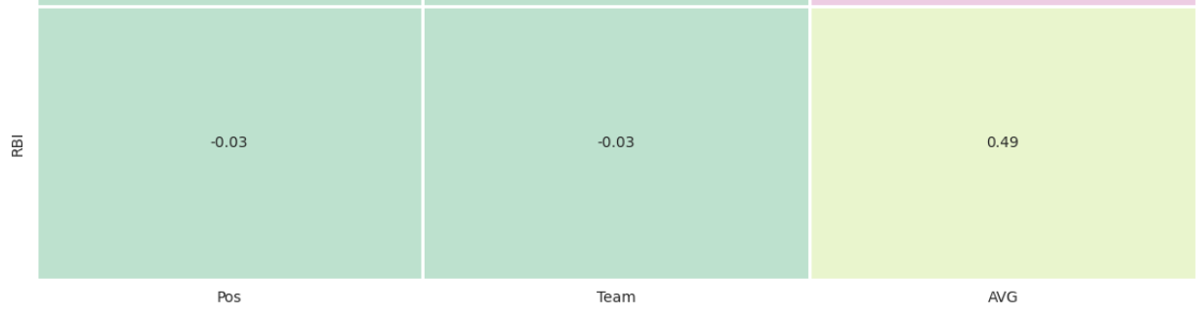
Exploratory Analysis
Multivariate analysis: moderate correlation of 0.49, higher batting averages have more RBIs
Batting Average (AVG) and Runs Batted In (RBI)

Slide 20
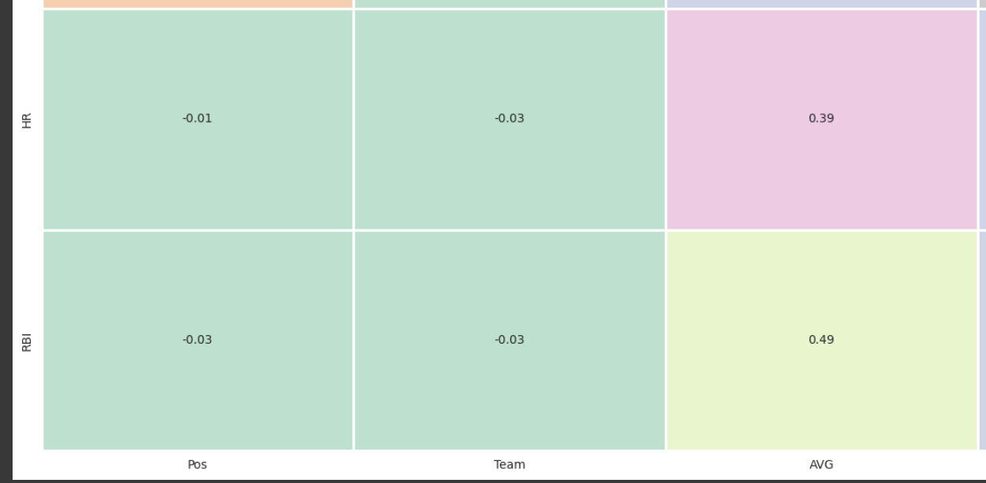
Exploratory Analysis
Multivariate analysis: moderate correlation of 0.39
Batting Average (AVG) and Home Runs (HR)

Slide 21
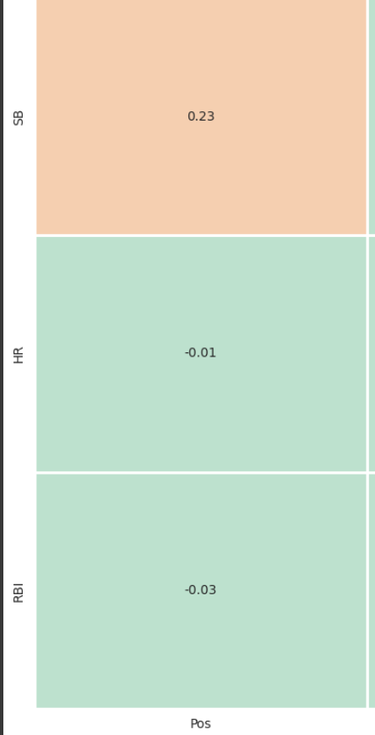
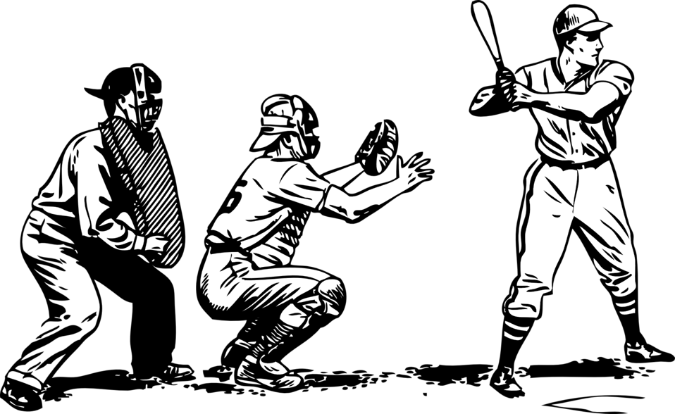
Exploratory Analysis
Multivariate analysis: low correlation of 0.23, certain positions more likely to steal bases
Position (Pos) and Stolen Bases (SB)

Slide 22
Challenges and Next Steps
Challenges
Missing players from the 2024 season who did not play in the 2023 season
Some players have changed teams for the 2025 season (calculated on old team)
Missing payer’s status (injuries)
Next Steps
Break down data for each team to compare the team's performance and identify trends
Look deeper into correlations since some statistics have a high variance
Broader range of data with more years to see how teams evolved and better forecast future

Slide 23
Resources and References
MLB 2023 Batting Statistics
https://www.rotowire.com/baseball/stats.php?season=2023
MLB 2024 Batting Statistics
https://www.rotowire.com/baseball/stats.php?season=2024
Cleaning, Merging, and Wrangling Google Colab Notebook
https://colab.research.google.com/drive/19WI1HbwaBem45U1j-MAMEhIr5qI1qyMa?usp=sharing
Exploratory Data Analysis Google Colab Notebook
https://colab.research.google.com/drive/1GY8oFHB6yD_9rchl7iA8kN6CLqczOZGu?usp=sharing
GitHub
https://github.com/csc442-team11/MLB-Data-Analysis.git

